Slide 1

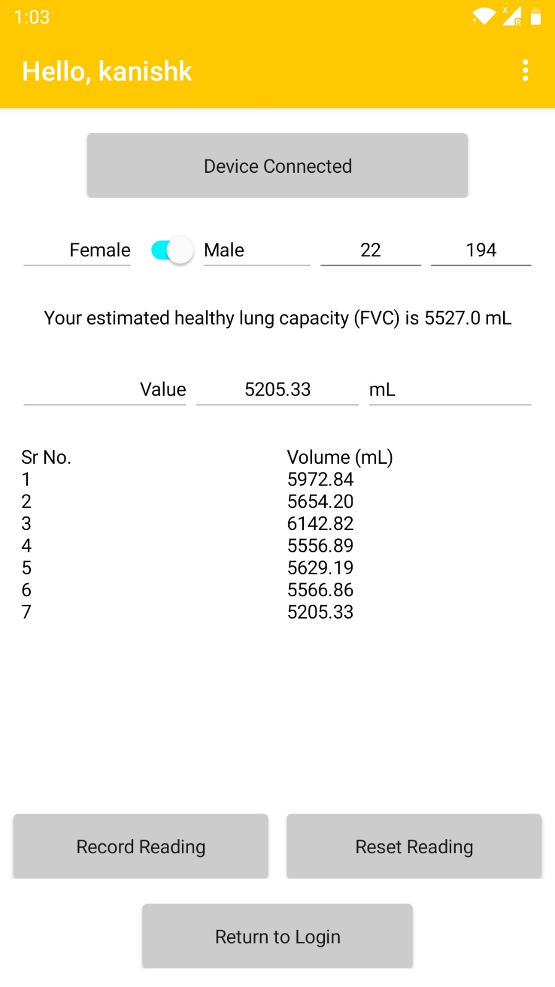
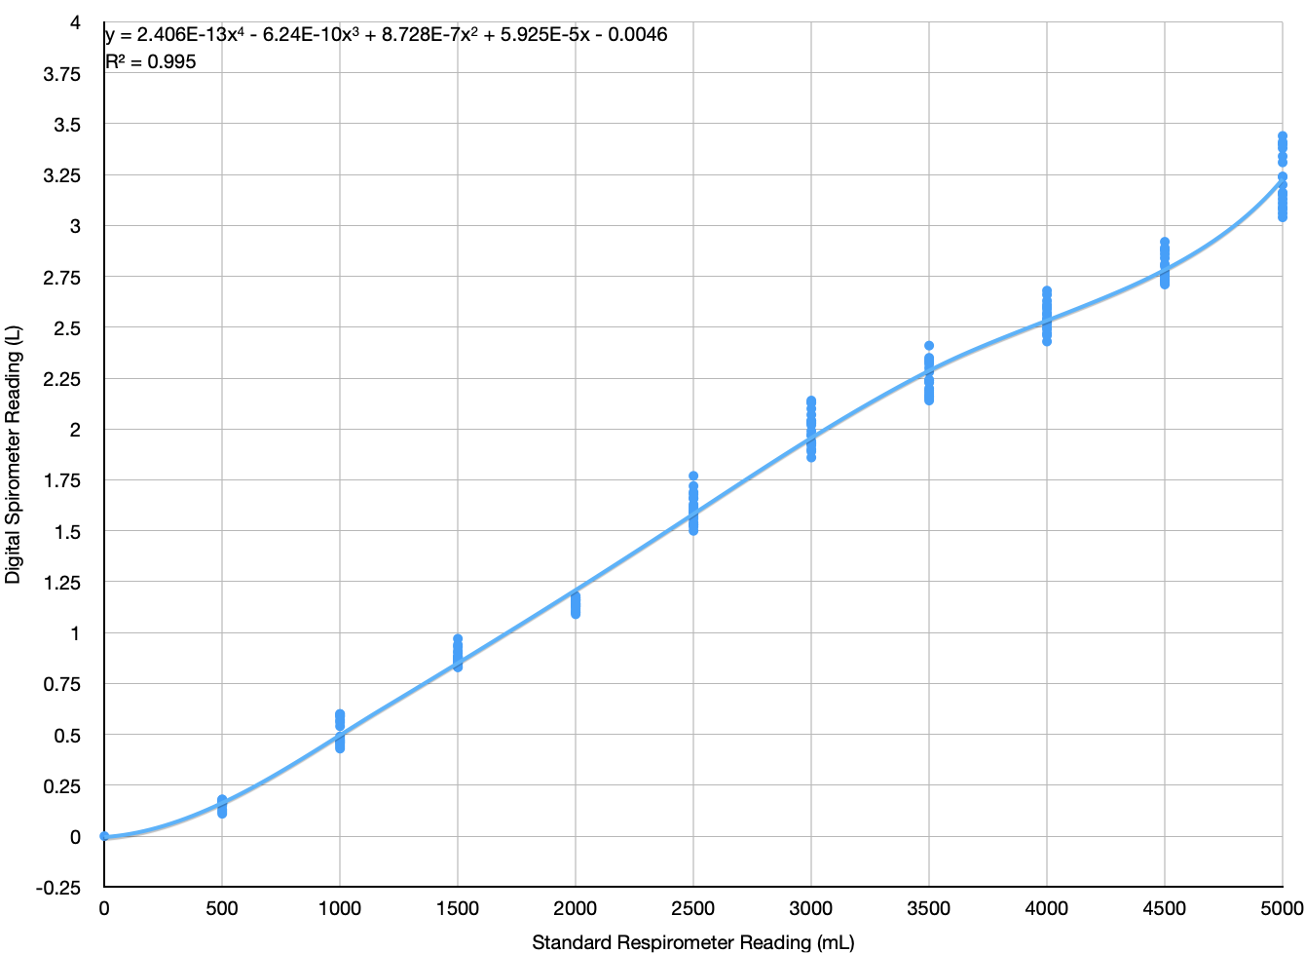
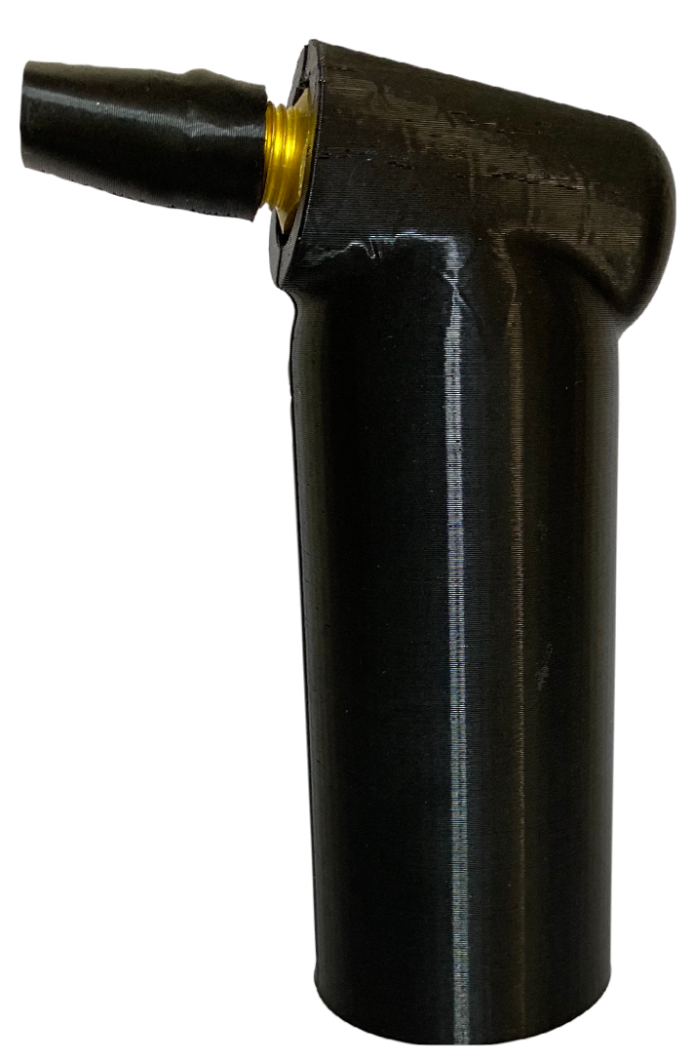
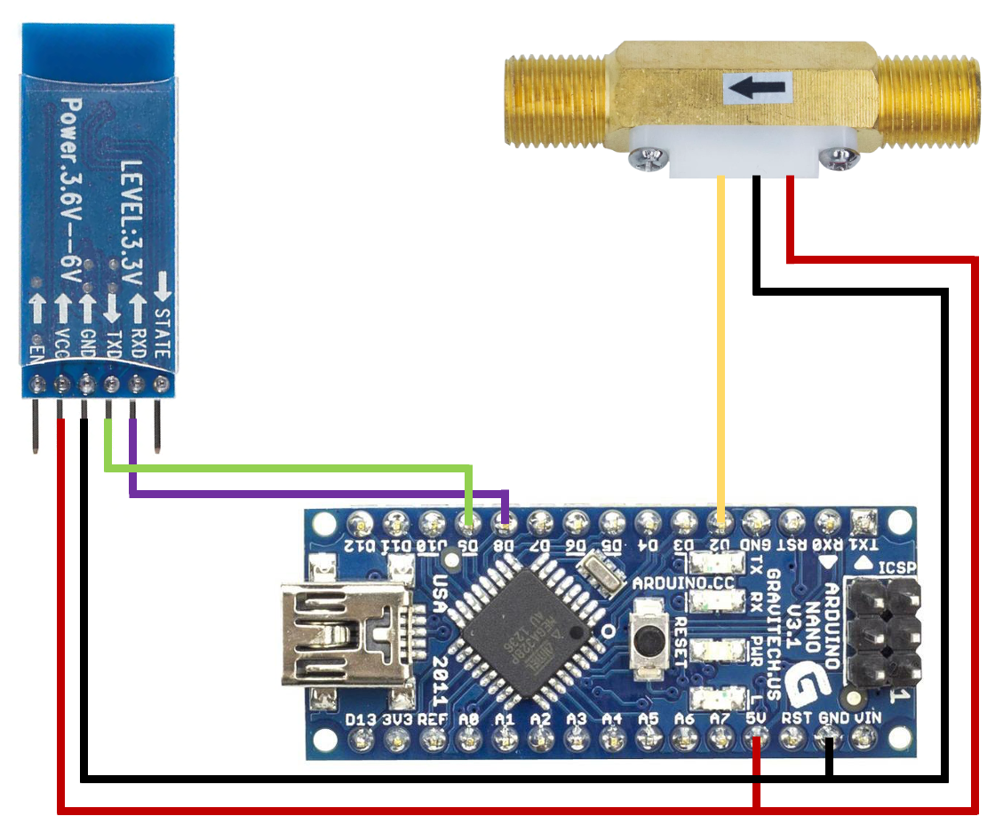
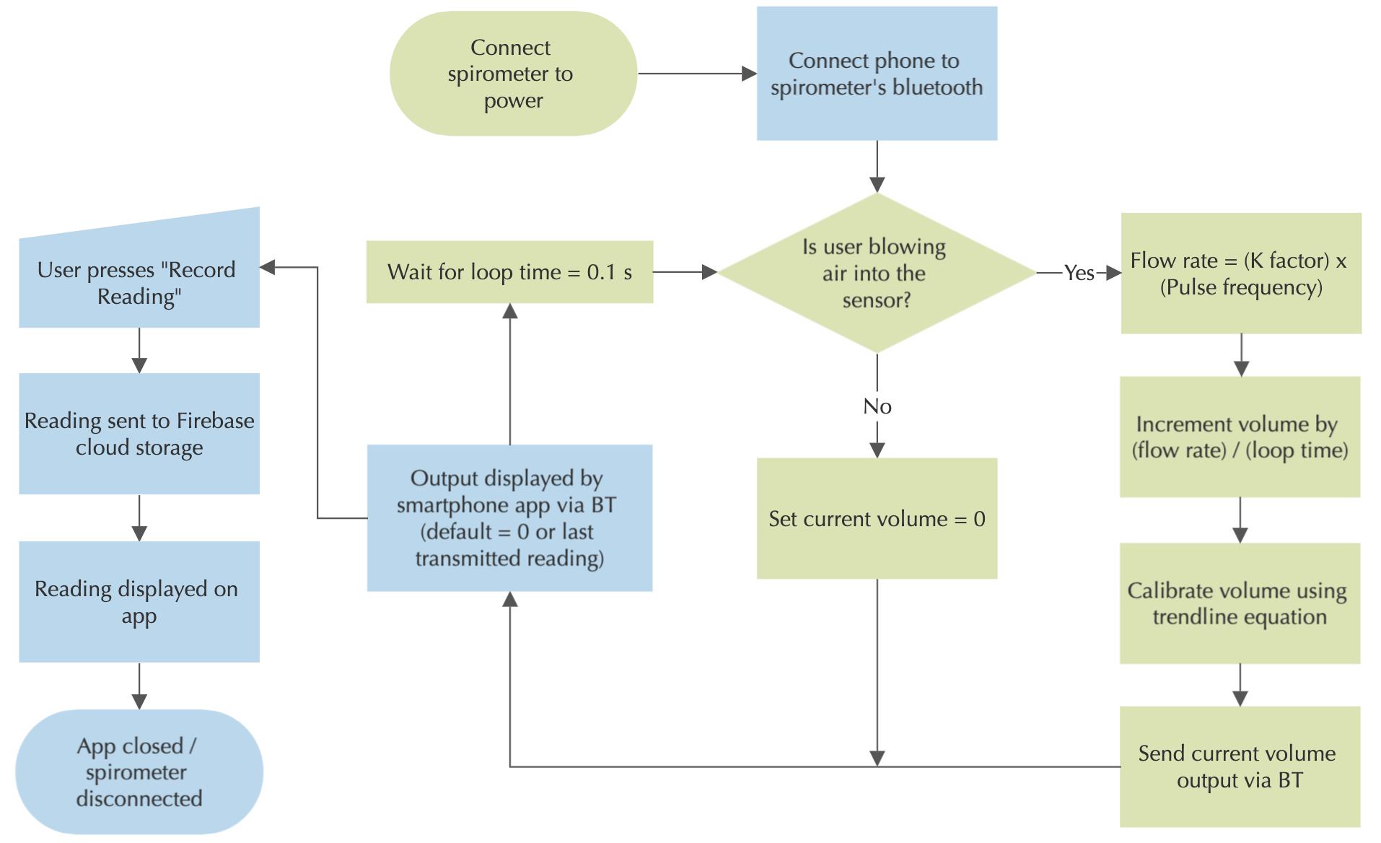
Developing an IoT-Enabled Digital Spirometer Prototype using Additive Manufacturing
Kanishk Chaudhary, Ritvik Rai, Divyansh Patel, T Lachana Dora
Introduction
The overall material required for 3D printing the product was 53.5 gram of PLA using 15% infill density. The funnel, through which the user blows air, is removable. Thus. multiple users can use the same spirometer. Cost of prototyping, including the Arduino Nano, BT module, wires, flowmeter and casing is ₹1249. Due to economies of scale, replacing Arduino with PLC, and cheaper plastic casing, cost of manufacturing can further reduce.
The device communicated with the app and provided readings for the user to save. Figures 4 and 5 show the app UI and the final device.
Spirometry sets the gold standard for the pulmonary function tests. It comes under the Randomized Controlled Trial (RCT) setting the benchmark for spirometry to be the best available benchmark for assessing the measures of lung function, specifically the amount and/or speed of air that can be inhaled and exhaled [1]. Spirometry is helpful in assessing breathing patterns that identify conditions such as asthma, pulmonary fibrosis, cystic fibrosis, and COPD. National and international guidelines advise spirometry to be an adequate, accurate and repeatable measurement of lung function.
Currently available spirometers in the market either use a piston or ball arrangement using gravity or are digital in nature with a screen showing the measures. However, the digital spirometers are expensive and cannot be afforded by a middle-class Indian family.
Figure 4: App interface
Methodology
The components were linked according to the circuit diagram given in Figure 1. The outer casing was 3D printed. The material selected was PLA, a biodegradable material made of plant starch. The digital spirometer was calibrated with a Romsons Breazer 5000 Respirometer, and the trendline equation was added into the Arduino code. An Android application was made, that can connect to the spirometer via Bluetooth. Figure 2 provides a flowchart for the working of the device and app.
The Forced Vital Capacity (FVC) is being calculated. Equations based on gender, age and height were taken as follows:
For males, Predicted FVC = –4.129 + (–0.0214 x age) + (0.0522 x height) (SEE = 0.422; R² = 0.52) [2]
For females, Predicted FVC = –0.902 + (–0.025 x age) + (0.027 x height) (SEE = 0.310; R² = 0.52) [2]
Figure 3: Device calibration with trendline
Figure 5: Spirometer prototype
Next Steps
Immediate next steps include displaying more data like FEV, interactive charts and dashboard, and further improving the device and app.
There lies a huge scope of research in the prediction of disease before the impact of the same abbreviates. Scope of research is increasing towards pre-disease detection. Non-invasive devices are usually accepted without any skepticism.
Biomarkers-led disease detection is one of the possible ways forward. Multiple body compounds in different concentrations are testimonial to different disease. Our breath can enable the same where analysis of compounds detected through the breath will clarify signs of any problematic disease. Some of the examples of such body fluids are yellow bile, black bile, phlegm water and blood air. This can help us towards detection of diseases such as asthma, tuberculosis, and more.
Figure 1: Circuit diagram of the digital spirometer
Potential Impact of Research
Lifestyle or Non-communicable diseases (NCDs) account for 71% of global deaths and has grown from 0.9 billion in 2018 to 1.06
billion in 2022. Although morbidity and mortality from NCDs mainly occur in adulthood but exposure to risk factors begins in early life.
The roots to any of these disease start at lungs. And measuring lung capacity can be an adequate measure of any disease detection. Facilitating same at a lower cost and from the comfort of user’s home and including this as a lifestyle device can be a possible solution for early diagnosis of most of these problems.
Figure 2: Flowchart showing working of the device and app. Note: Green refers to the spirometer, blue refers to the Android app.
References
[1] Lusuardi, M., De Benedetto, F., …, Donner, C. F. (2006). A randomized controlled trial on office spirometry in asthma and COPD in standard general practice. Chest, 129(4), 844–852. https://doi.org/10.1378/chest.129.4.844
[2] Dasgupta, A., Ghoshal, A., … Sengupta, S. (2015). Reference equation for spirometry interpretation for Eastern India. Lung India, 32(1), 34. doi:10.4103/0970-2113.148443
Results
Linear trendline gave R² = 0.9918 and a polynomial trendline of order 6 gave the highest R² = 0.995. Figure 3 provides the calibration chart.
Notes:
Pre-disease detection without going to the hospital
Also, broader impact: how knowledge gained in this project can be applied to help solve other problems

